Slide 1
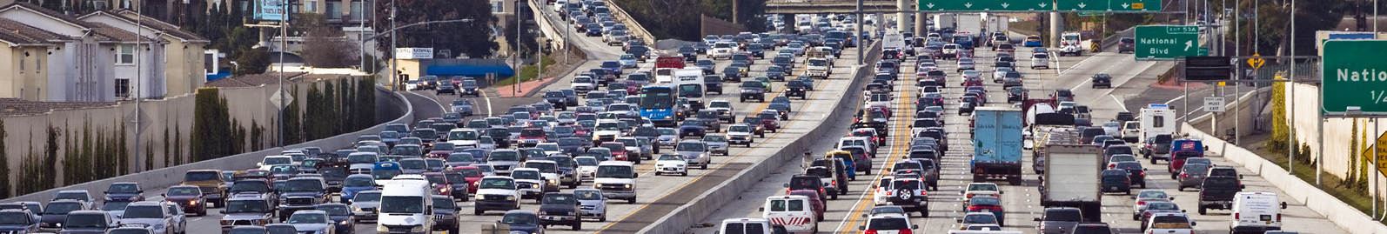
Analyzing Collision Events in Seattle and Predicting Severe Occurrences
Sayan Das
1/3/20

Slide 2
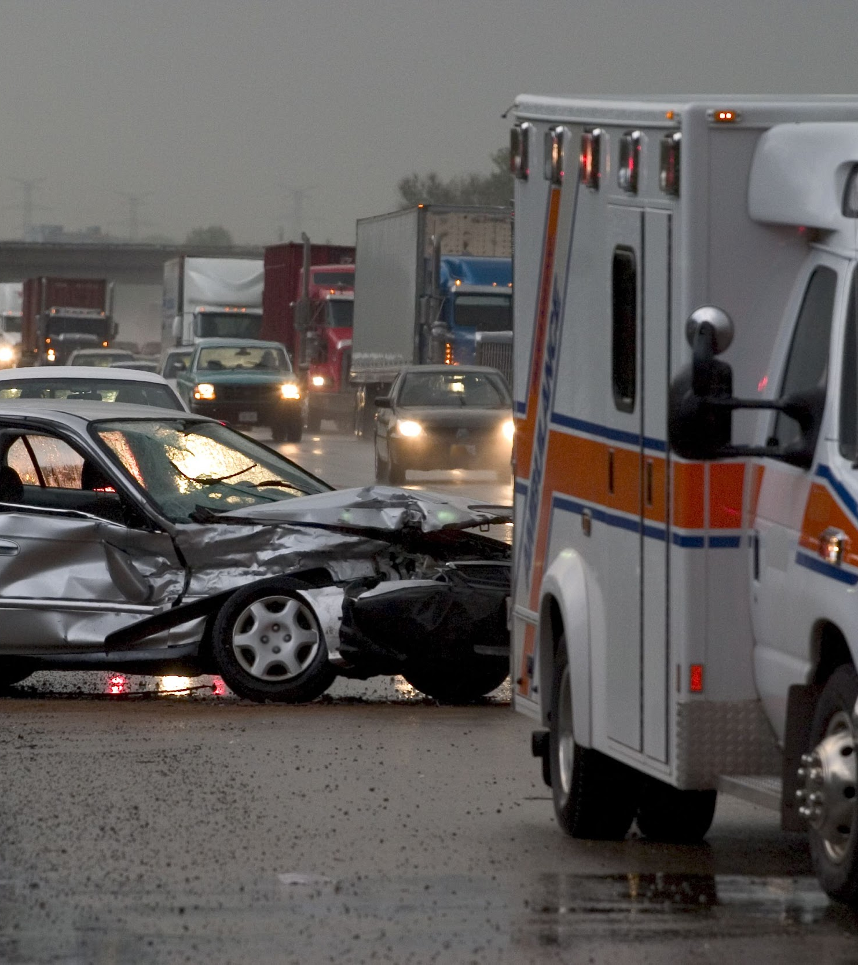
Why Do We Care About Collision Severity?
This is a presentation

Slide 3
Problem
6,452,000 motor vehicle crashes and 37,133 crash-related deaths in 2017 alone.
Significant costs in terms of life, money and property incurred
Number of vehicles in the US keeps growing every year
Need to adopt greater safety measures on the road

Slide 4
Solution
Insurance companies play a significant role in minimizing and handling automobile collisions. Provide services by charging insurance premiums
Need to more accurately determine insurance rates through prediction
Use machine learning to predict severe collisions and explore important factors

Slide 5
Audience
Big insurers in the US such as Statefarm, Esurance and Allstate have stated location as one of their top criteria for determining rates.
Insurance companies could use this model to determine more accurate rates for their customers.
Use this information to alert their clients regarding red flags when buying expensive cars in more accident prone locations which would likely increase their insurance premiums.
Other Applications
Alerts for rideshare companies
Google and Apple who provide mapping apps
Traffic control departments could collect this data firsthand and make it available to the aforementioned companies.

Slide 6
Data Description
Data acquired from the City of Seattle Open Data Portal, consisting of 212,760 instances of vehicle collisions in Seattle with 40 features with timeframe ranging from 2004-2018.
Data for each variable was extracted using the ArcGIS REST API in .csv format, available on the Seattle GeoData page.
Neighborhood feature extracted using reverse_geocoder library. Tomtom API used to extract Speed variable. HERE API used to acquire Road Length and Road Congestion variables.

Slide 7

Data Cleaning
This is a presentation

Slide 8
Process
Selecting Initial Variables
Removed redundant variables
Removed variables with many unique categories
Removed variables with many missing values
Renaming Columns
Handling Missing Values & Formatting
Latitude/Longitude
Address Type
Weather
Road/Light Condition
DUI
Junction Type, Collision Type
Severity Description
Adding New Variables
Neighborhood
Speed
Road Length
Road Congestion
Dealing With Outliers
Transforming Date Variables

Slide 9
Geographical Factors
Key Findings
Most collisions are concentrated in the Seattle neighborhood
The center of Seattle have the highest density of collisions
Locations along roads and highways are common collision prone areas

Slide 10
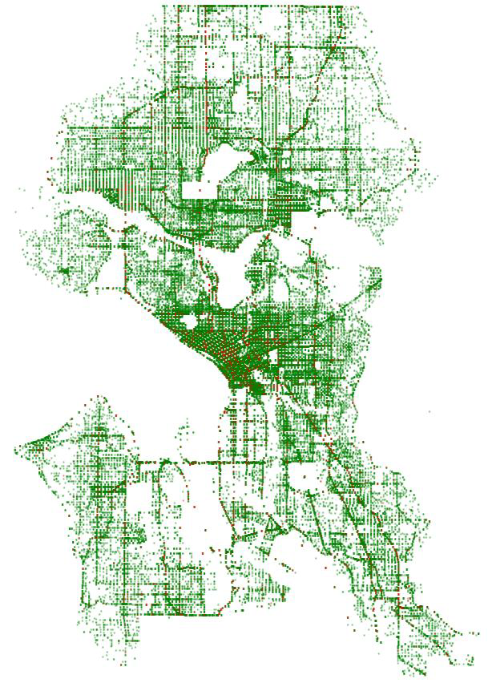
Collision locations visualized using scatterplot of coordinates
Points on plot essentially maps out the entire Seattle area
Severe (red) incidents sparsely distributed compared to non-severe (green) incidents

Slide 11
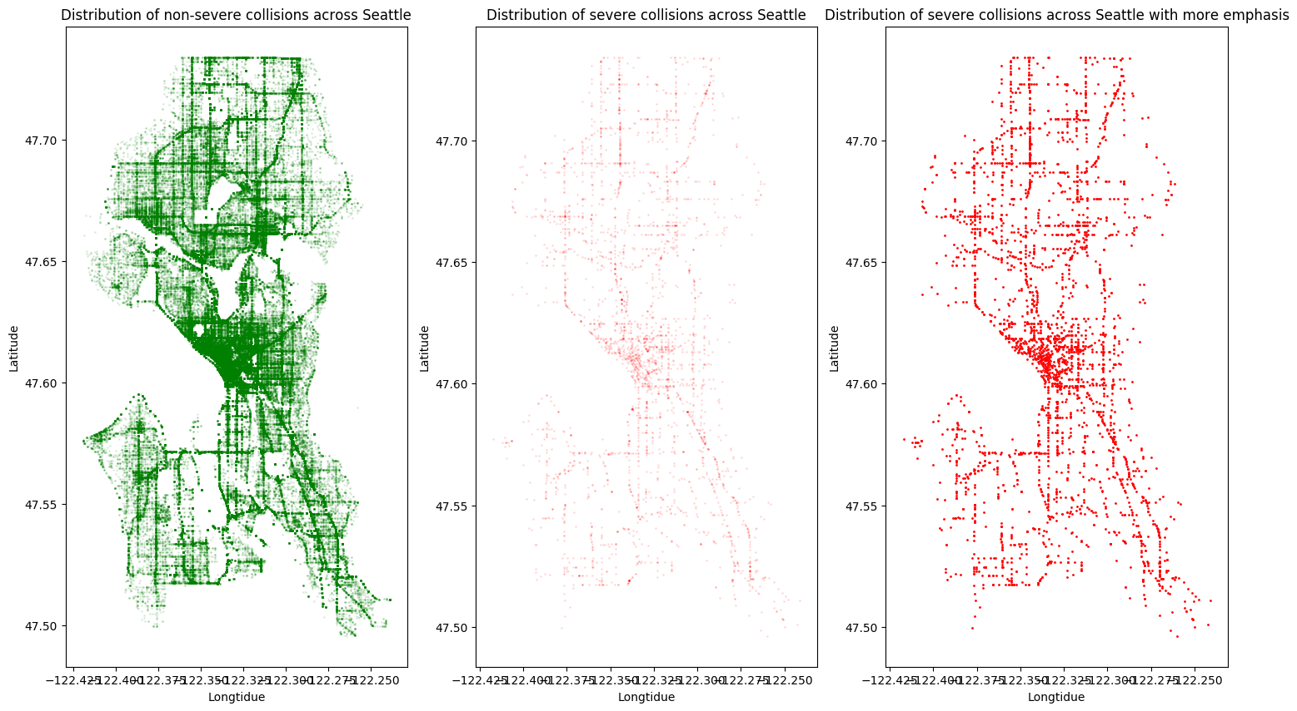
Key Areas of Dense Severe Collisions
Center of the city: highest density of crashes
Aurora Ave North: road going north
Rainier Ave South: road going south-east
15th Ave Northwest: road going north-west
Lake City Way Northeast: road going north-east
24th Ave East: vertical road towards the east

Slide 12

Time Series Analysis

Slide 13
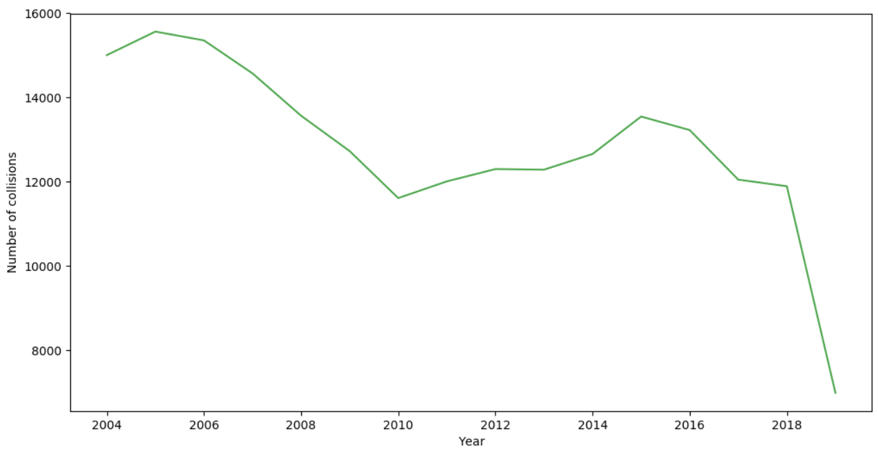
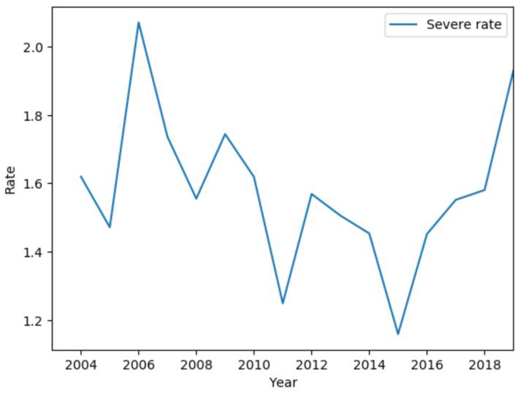
Collisions Over The Years
Average collisions over the years shows a downward trend from 2006 to 2011 followed by an upward pattern till 2016.
From 2017 to 2019, there is a sharp downward trend.
Avg Severity Rate Over The Years
Sharp increase from 2005-2006 followed by slump till 2008
Small increase till 2009, then sharp downward trend till 2011
Sharp Increase till 2012 followed by downward pattern till 2015
From 2015, sharp upward trend

Slide 14
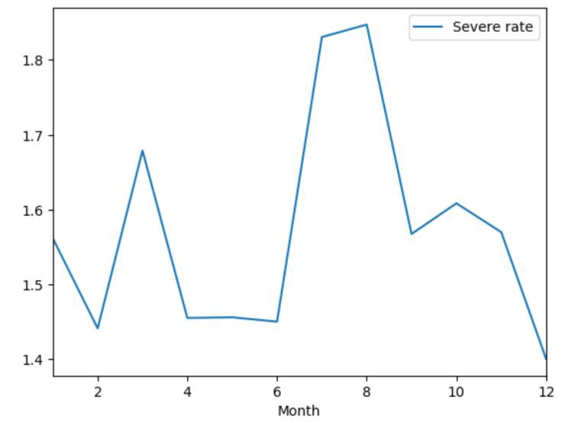
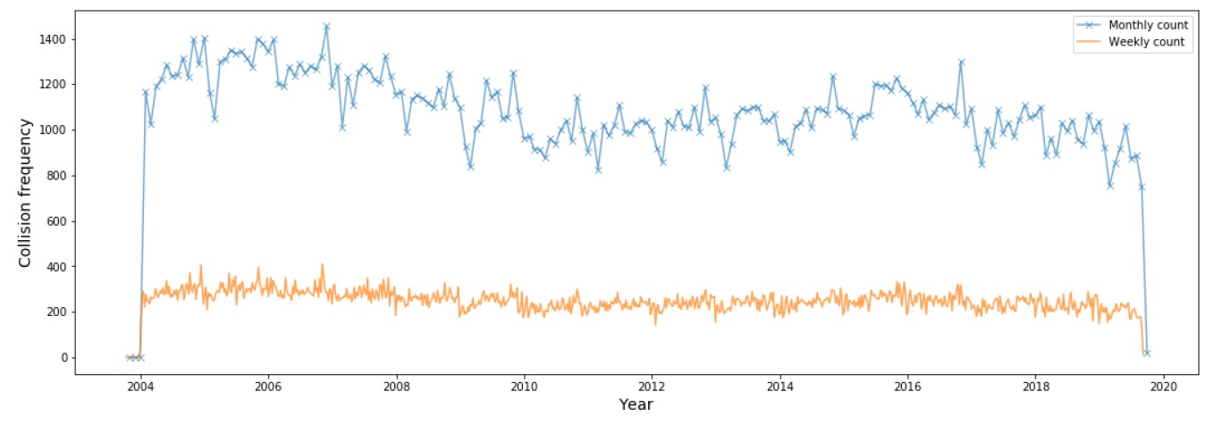
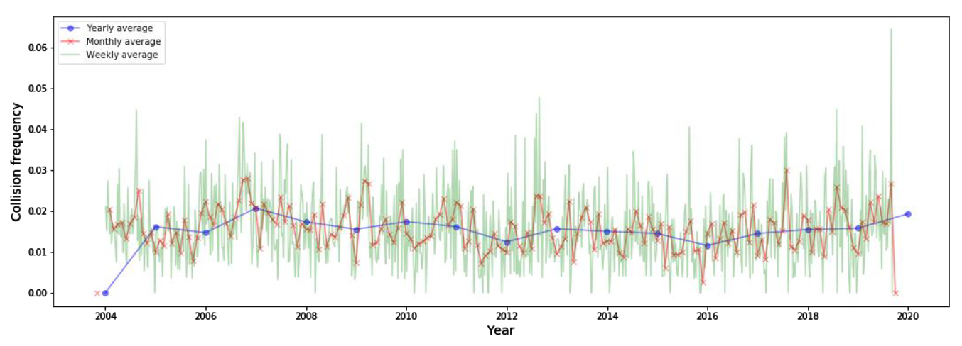
Average severity rate (top left) is distinctly higher during July and August. April to June as well as winter months of Feb and Dec see the lowest rates. Average monthly and weekly plots (top right) shows indistinct peaks.
Avg Yearly/Weekly/Monthly Collision Rates Across Time
Points higher in value represent more severe collisions. All points have values closer to 0 due to class imbalance. Due to the much larger proportion of non-severe cases, an averaged point is likely to be skewed towards 0.

Slide 15
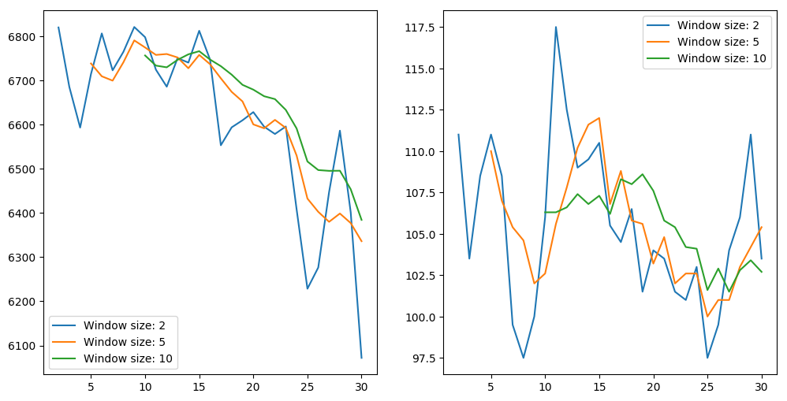
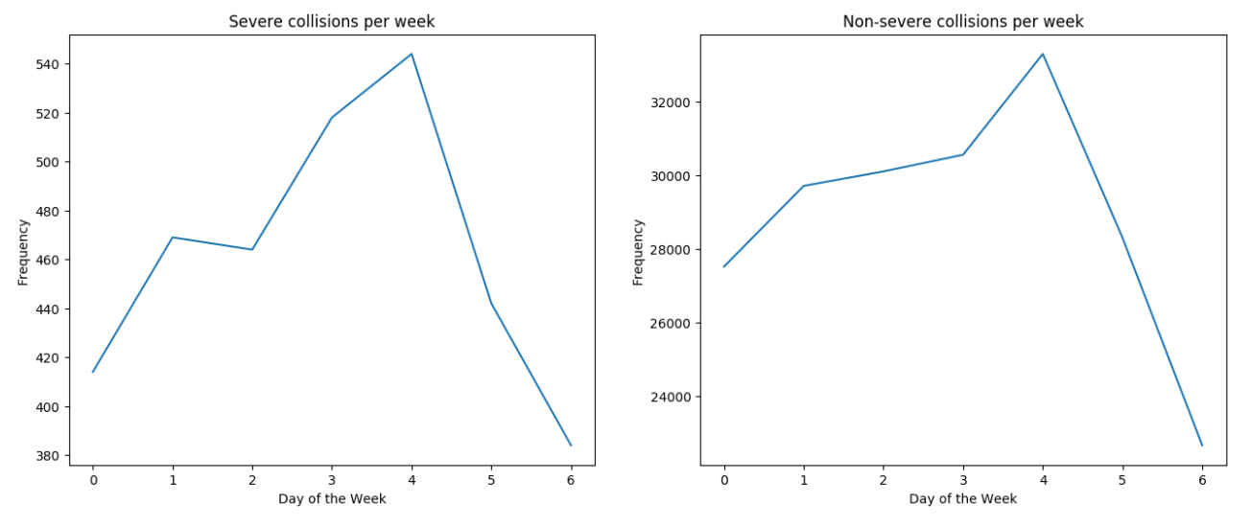
Key Findings
Chi-squared test for independence between day of month and severity suggests a weak association. Day of the week vs severity also suggests a weak relationship.
Curve for non-severe (top left) moving avg has a smoother downward trend. The severe trend sees fluctuations during the early days but has a downward trend from day 15 onwards.
In the bottom plots, Friday (4) sees the highest avg collisions while Sunday (6) sees the lowest. Trends for severe and non-severe cases are identical.
Day of month vs Severity
Chi-squared: 14.2364
DF: 30
P-value: 0.99
Day of the week vs Severity
Chi-squared: 5.7106
DF: 6
P-value: 0.456377

Slide 16
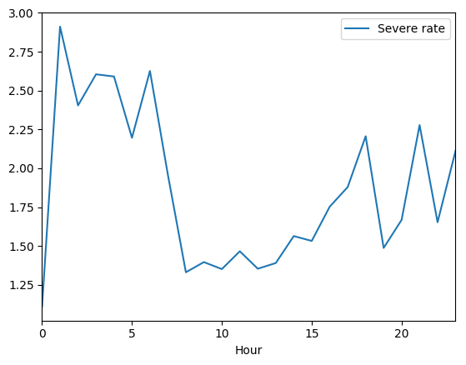
Severity Rate Across Hour of the Day
Hourly average severity collision rates shown with ‘0’ indicating 12am and ‘23’ indicating 11pm.
Hours between 1am and 6am see a higher rate of severe collisions. The case is similar for 4pm-6pm, 9pm and 11pm.
Surprisingly the the lowest rate is seen at 12am.
Hours between 8am and 3pm see the lowest severe collision rates which is somewhat expected since light conditions tend to be favorable during this period.
Chi-squared test between hour and severity shows a significant association.
Hour vs Severity
Chi-squared: 249.5802
DF: 23
P-value: <0.00001

Slide 17

Multivariate Analysis

Slide 18
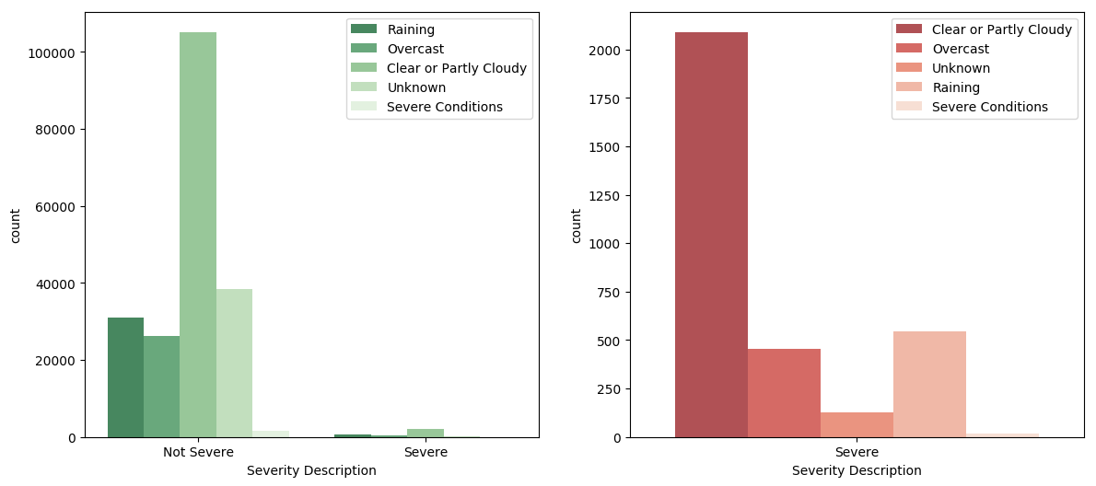
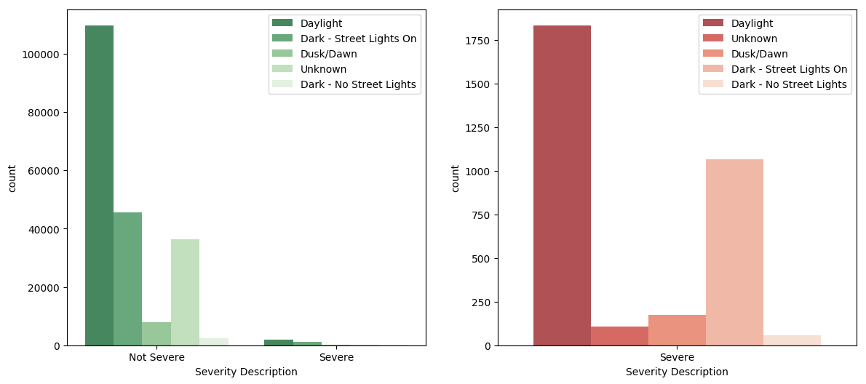
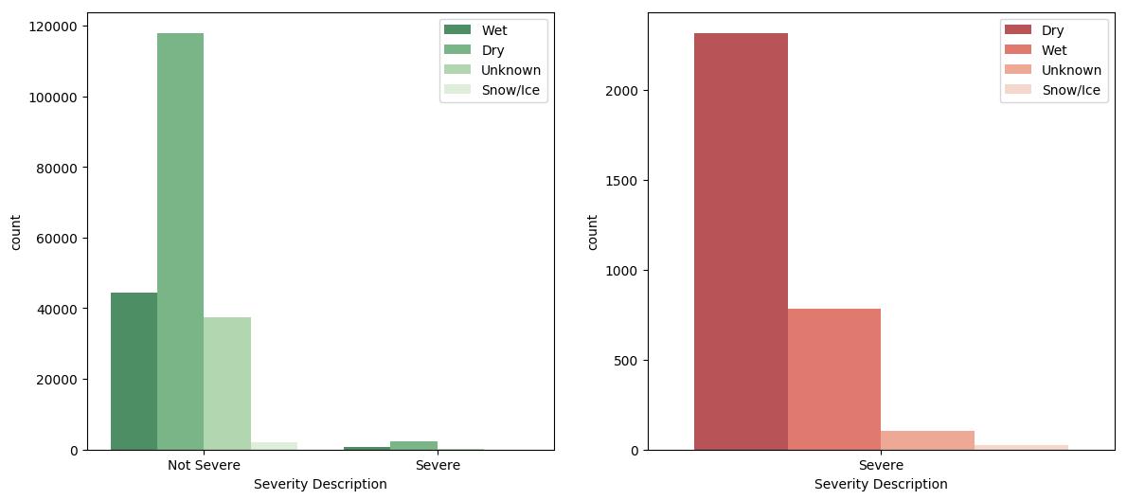
Weather vs Severity
Chi-squared value: 492.9949
Degrees of freedom: 4
P-value: <0.00001
Key Findings
Chi-squared test for independence between weather-related variables and severity suggests a strong association.
However, bar graphs do not suggest an obvious relationship.
Light Condition vs Severity
Chi-squared value: 566.0597
Degrees of freedom: 4
P-value: <0.00001
Road Condition vs Severity
Chi-squared value:511.8966
Degrees of freedom: 3
P-value: <0.00001

Slide 19
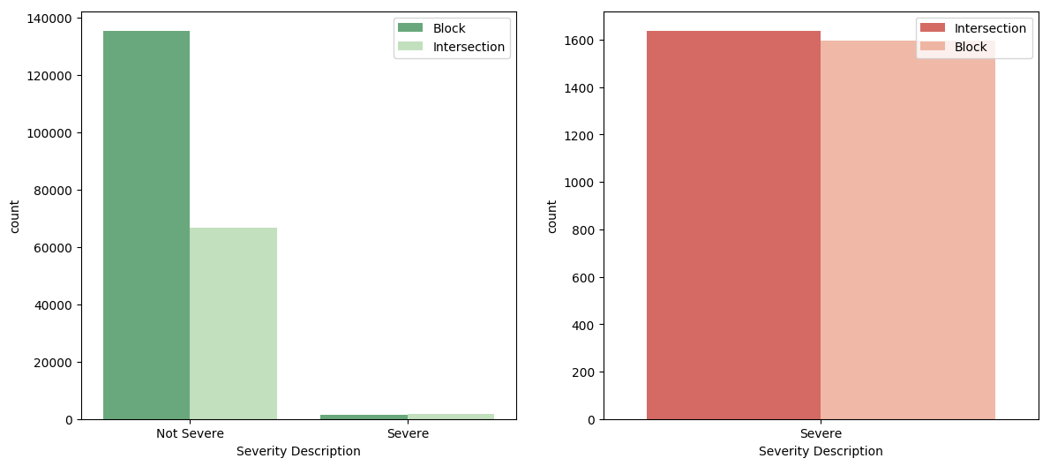
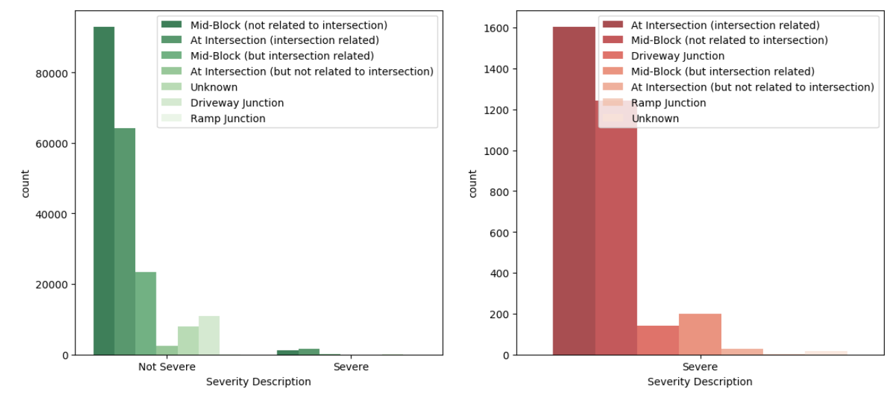
Key Findings
Chi-squared test for independence for both Address Type and Junction Type against severity suggests a strong association.
The bar graphs for Address Type suggests that for the non-severe class, the ‘block’ category is twice more frequent suggesting some association with severity.
Similarly, for Junction Type, ‘mid-block’ is more frequent for non-severe instances whereas ‘intersection’ is more frequent for severe cases.
Address Type vs Severity
Chi-squared: 443.8558
DF: 1
P-value: <0.00001
Junction Type vs Severity
Chi-squared: 547.7693
DF: 6
P-value: <0.00001

Slide 20
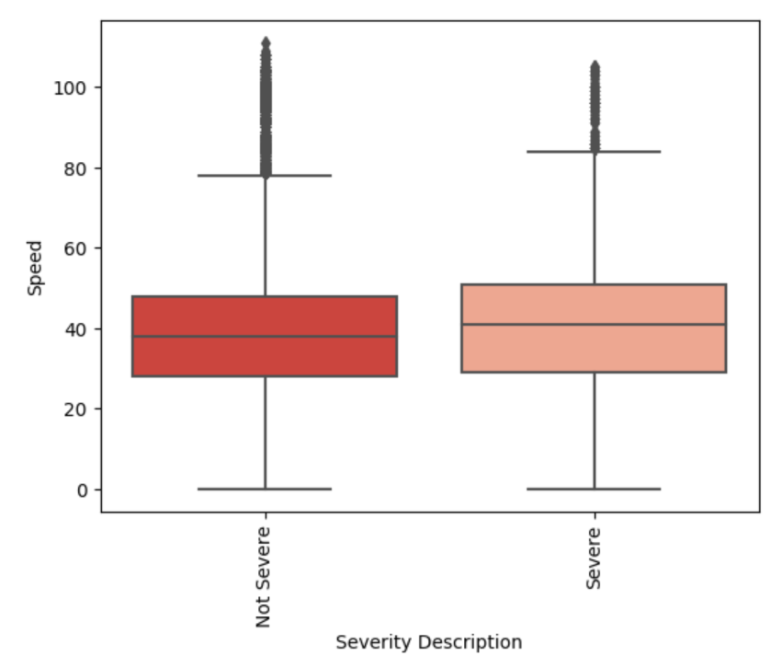
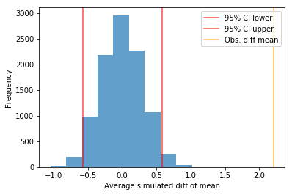
Key Findings (Speed vs Severity)
Boxplots suggest that median traffic flow speed is slightly higher for severe cases.
Hypothesis testing via simulations using permutation replicates indicates that the probability of observing the actual difference in mean speed between severe and non-severe cases is significant, whereby validating the boxplot findings.
Stats
Obs diff mean: 2.212
95% CI: -0.599, 0.603
Significance level: 5% (0.05)
P-value: 2.055e-13

Slide 21
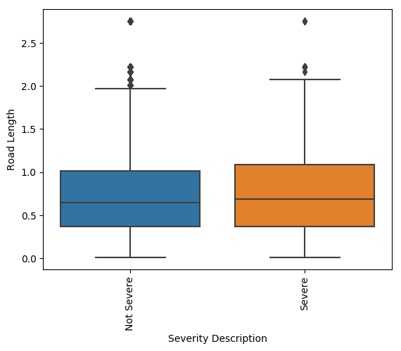
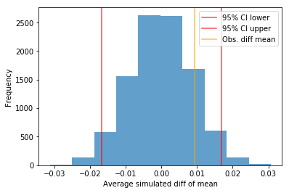
Key Findings (Road Length vs Severity)
Boxplots suggest that median road length is slightly higher for severe cases.
Hypothesis testing indicates that the probability of observing the actual difference in mean road length between severe and non-severe cases is not significant (p-value > 0.05)
Stats
Obs diff mean: 0.0093
95% CI: -0.166,0.0168
Significance level: 5% (0.05)
P-value: 0.138

Slide 22
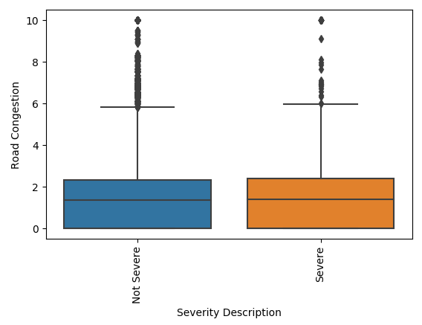
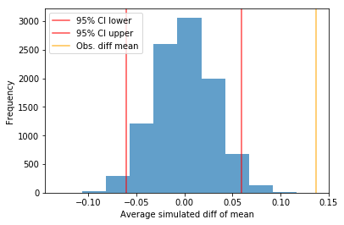
Key Findings (Road Congestion vs Severity)
Boxplots suggest that median road congestion is slightly higher for severe cases.
Hypothesis testing indicates that the probability of observing the actual difference in mean road congestion between severe and non-severe cases is significant.
Stats
Obs diff mean: 2.212
95% CI: -0.0601, 0.0597
Significance level: 5% (0.05)
P-value: 8.788e-6

Slide 23

Modeling and Evaluation

Slide 24
Process
Pre-processing
Label encoding
Feature scaling
Feature Selection
Train test split
Hyperparameter Tuning
Grid Search
Cross Validation
Model Selection
LightGBM
Logistic Regression
Random Forest
Model Evaluation
ROC AUC, Accuracy, Misclassification
Confusion Matrix
Tuning ROC AUC Threshold
Final Model

Slide 25
Final Model Details
Algorithm: LightGBM
Key Parameters:
Max depth: 5
Number of leaves: 10
Learning rate: 0.1
Min data in each leaf: 20
Threshold: 0.02
Model Evaluation
Best ROC AUC score: 0.66
Confusion matrix:
True positives: 493
False negatives: 474
False positives: 17697
True negatives: 42771
Accuracy: 0.7042
Misclassification error: 0.2957

Slide 26
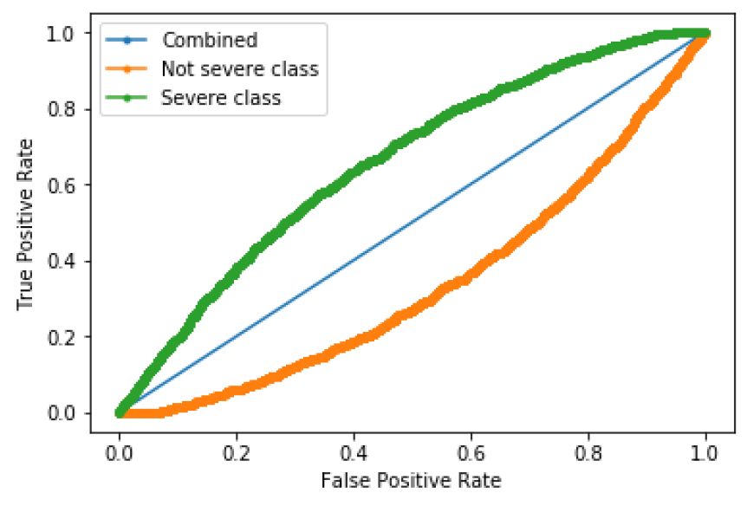
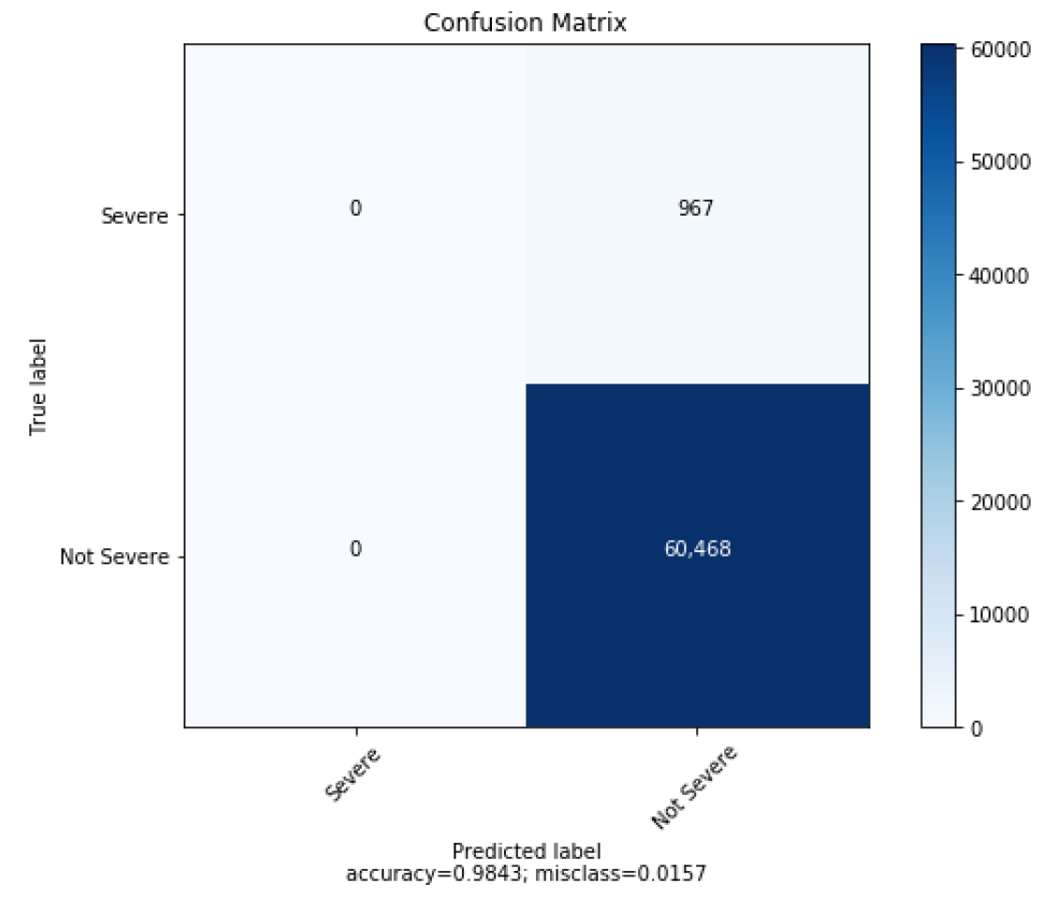
Key Findings (ROC Curve)
Final model yielded a severe class ROC AUC score of 0.66
Curves for non-severe and combined classes also shown
Key Findings (Confusion Matrix)
None of the severe cases were being predicted due to class imbalance.
Hence, the thresholds were tuned to increase the number of TP results and decrease the number of FN results (shown on slide 26).

Slide 27
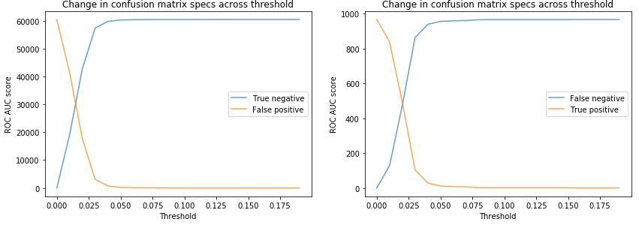
Score
Score
Key Findings (Threshold Sweep)
Threshold values are swept from 0 to 1 with a step size of 0.01 to visualize changes in the confusion matrix values.
True positives increase with increasing false positives and decreasing false negatives
True negatives decrease with increasing false positives
Significant changes are only observed at a threshold lower than 0.05

Slide 28
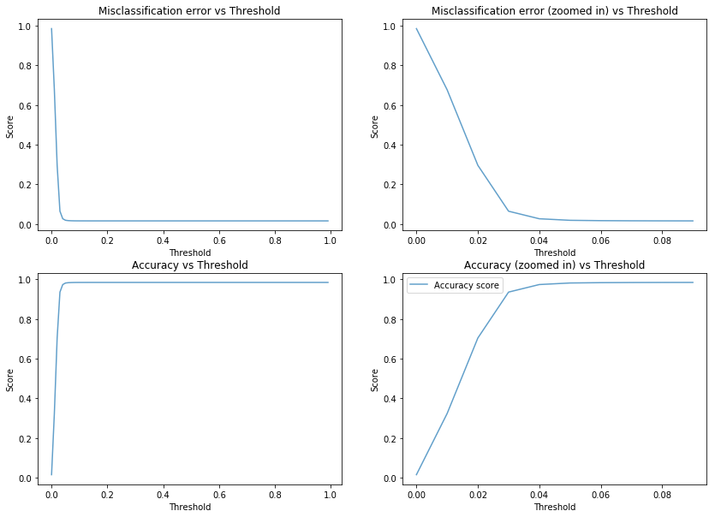
Key Findings (Accuracy and Misclassification)
As threshold is decreased, accuracy decreases while AUC remains the same as we are just moving along the AUC curve.
As threshold decreases, events go from TN to FP whereby decreasing the accuracy and increasing the misclassification error
Similarly, values go from FN to TP for decreasing threshold.
In our application where detecting severe collisions is the most important criteria, this is a fair tradeoff to consider.

Slide 29
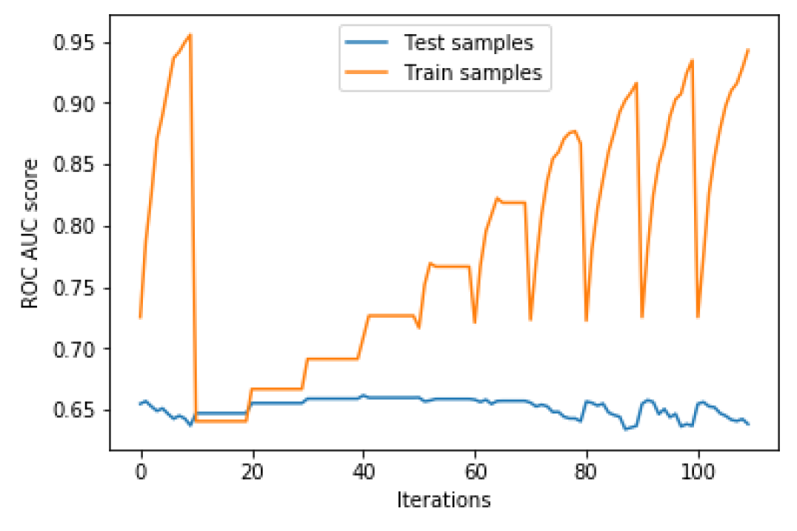
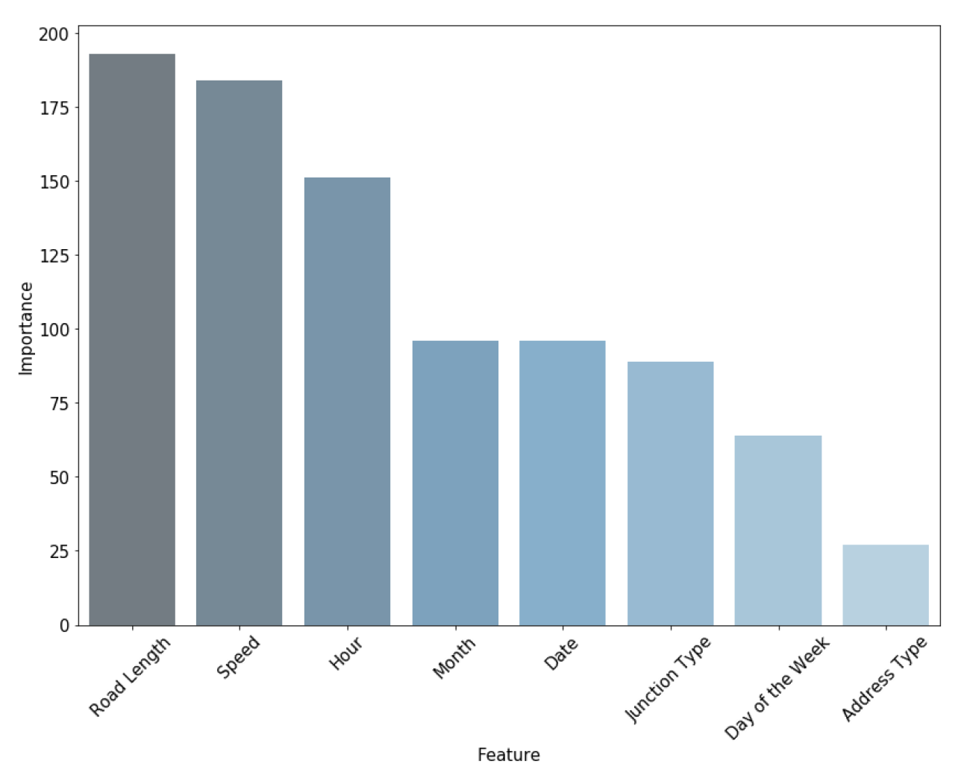
Handling Overfitting
Top left graph shows ROC AUC scores for train and test samples across number of leaves and max depth hyperparameters.
Points between 10-20 offer the best model in terms of overfitting.
Each test sample point above 20 increases train performance by a higher rate, the ideal points being between 10-40.
Important Features
Road Length and Speed are the best predictors of severe collisions followed closely by Hour
Month, Date and Junction Type have similar effects on the model
Day of the Week and Address Type are the worst predictors

Slide 30
Conclusion
The center of the city as well as routes along major roads going north, south and east have a relatively higher density of severe incidents
Class imbalance made prediction of the severe (minority) class difficult. Oversampling methods such as SMOTE were not effective in dealing with the imbalance problem since not many features explained the variance in severity classes well.
Location-based features such as Weather, Road/Light Condition and Neighborhood provide little information. The more important variables turned out to be ones related to traffic flow, road dimensions, date and time.
An optimized LightGBM model provided a ROC AUC score of 0.66 and zero true positive values due to imbalance. This was tackled by adopting a threshold value of 0.02 which yielded 493 TP, 474 FN, 17697 FP and 42771 TN. Accuracy was 0.7042 with a corresponding misclassification error of 0.2957.
Since it’s more critical to predict severe collisions correctly, a lower threshold was selected in order to generate more true positives at the expense of a higher false positive rate.

